Slide 1
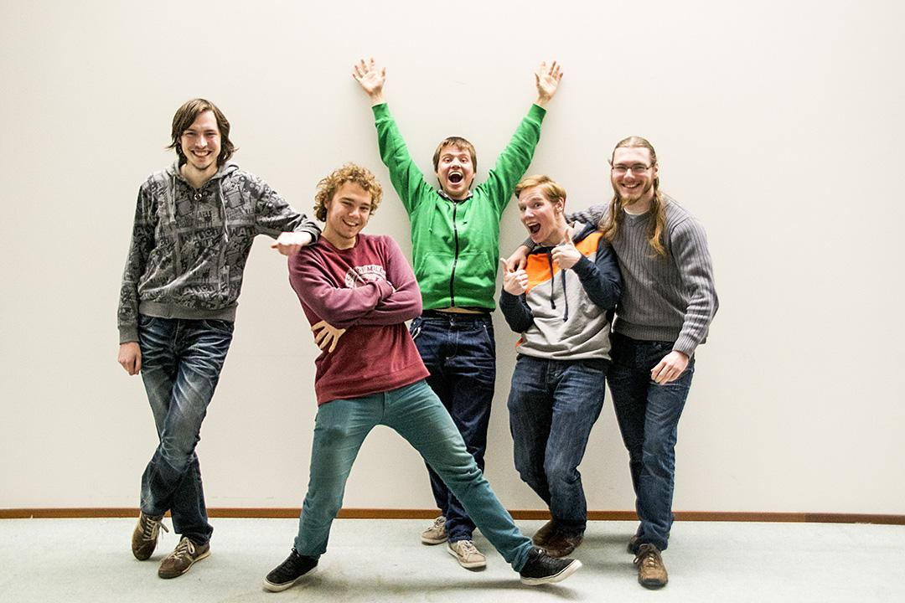

Kevin Cleijne, Jeroen van Hoof, Pieter Kokx,
Twan van Schijndel and Joep Klein Teeselink

Slide 2
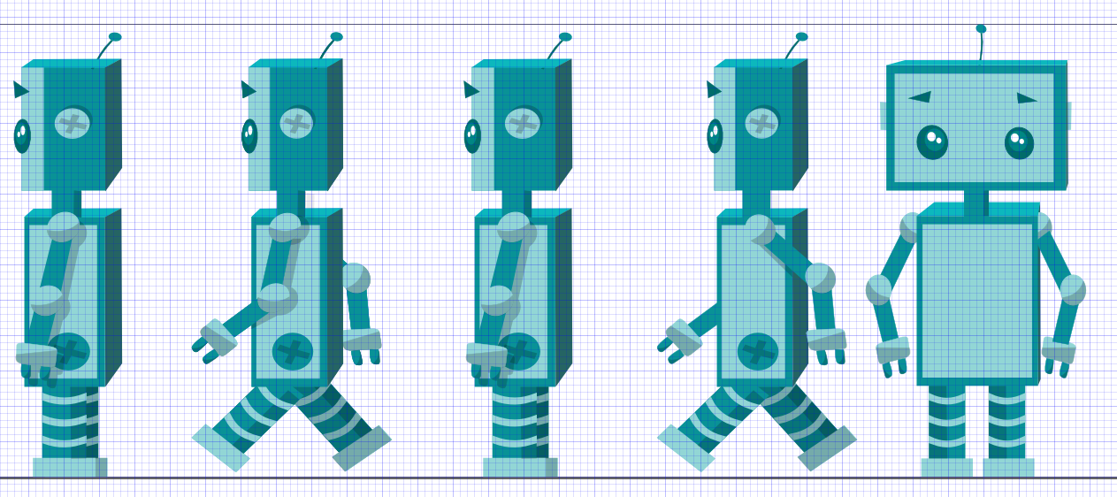
Story
Notes:
> Story (1/3)
This is the story about a little robot called Jumper.

Slide 3
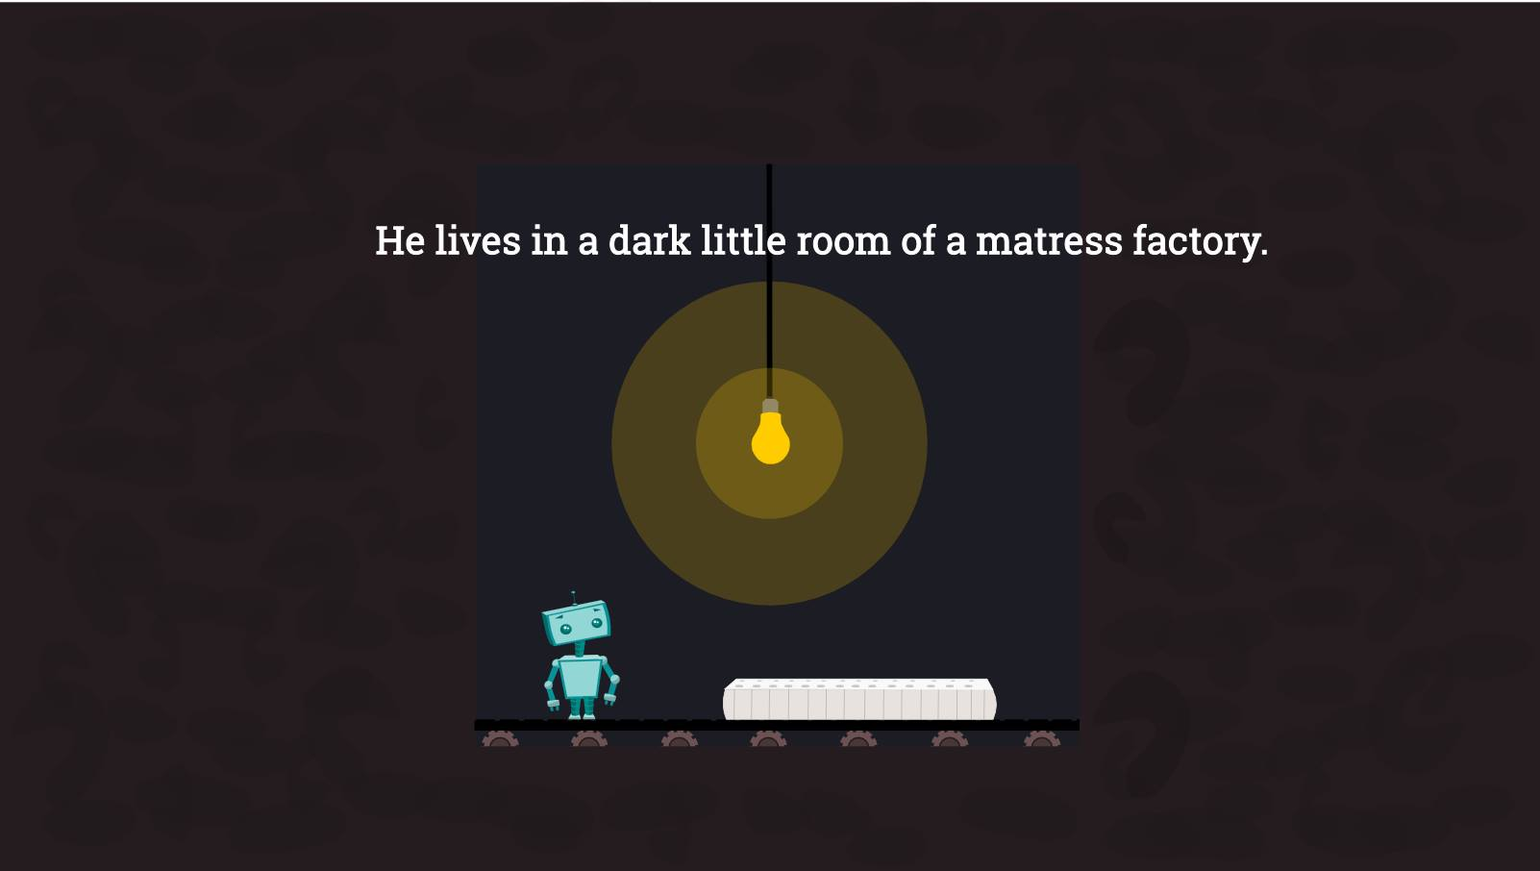
Notes:
> Story (2/3)
Jumper lives in a dark little room of a mattress factory, where he tests matresses (by jumping on them).

Slide 4
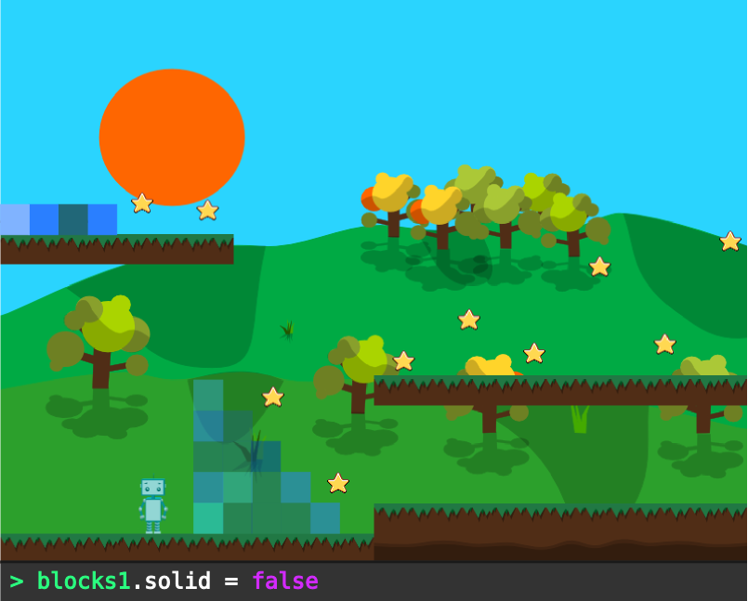
Notes:
> Story (3/3)
One day, he discovers a glitch in the wall...
He escapes and starts exploring the world, where he learns to program!

Slide 5
> Objective
Create a serious game to pique interest in computer science
Provide a fun, easy and safe way to experiment with programming
Let the player discover its own creative solutions to solve a level

Slide 6

> Key Focus
Experiment with programming concepts
Derive a solution using programming skills as a superpower
Aquire new programming functions (abillities)

Slide 7
> How
2D Puzzle Platformer
Interact with Environment:
Console Commands
Jump, collect, code
Solve Puzzles by Programming the World

Slide 8
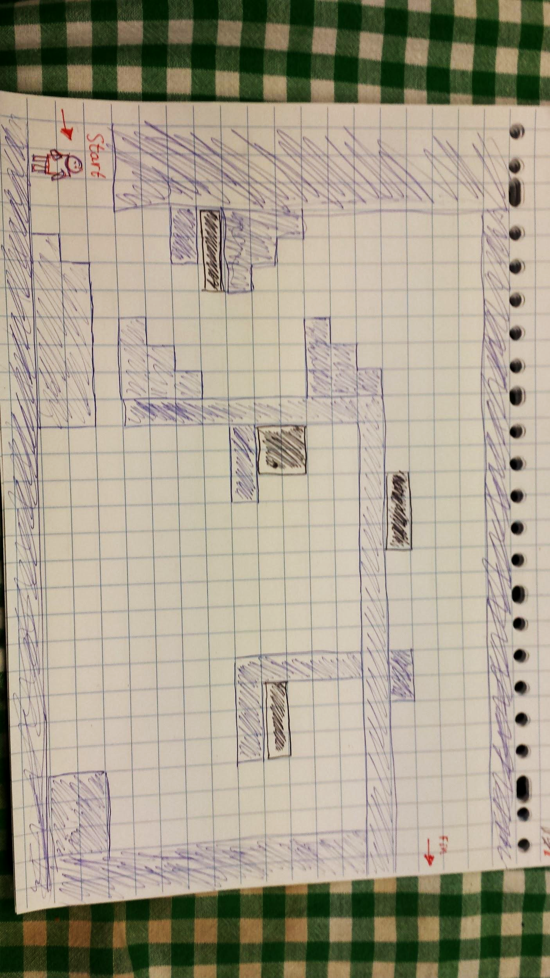
Notes:
> Basic Level Components
Moveable blocks (with commands)
Blocks fall down if they have nothing beneath them.
Robot can only jump one block high
Move the block via programming
Goal: get to the end

Slide 9
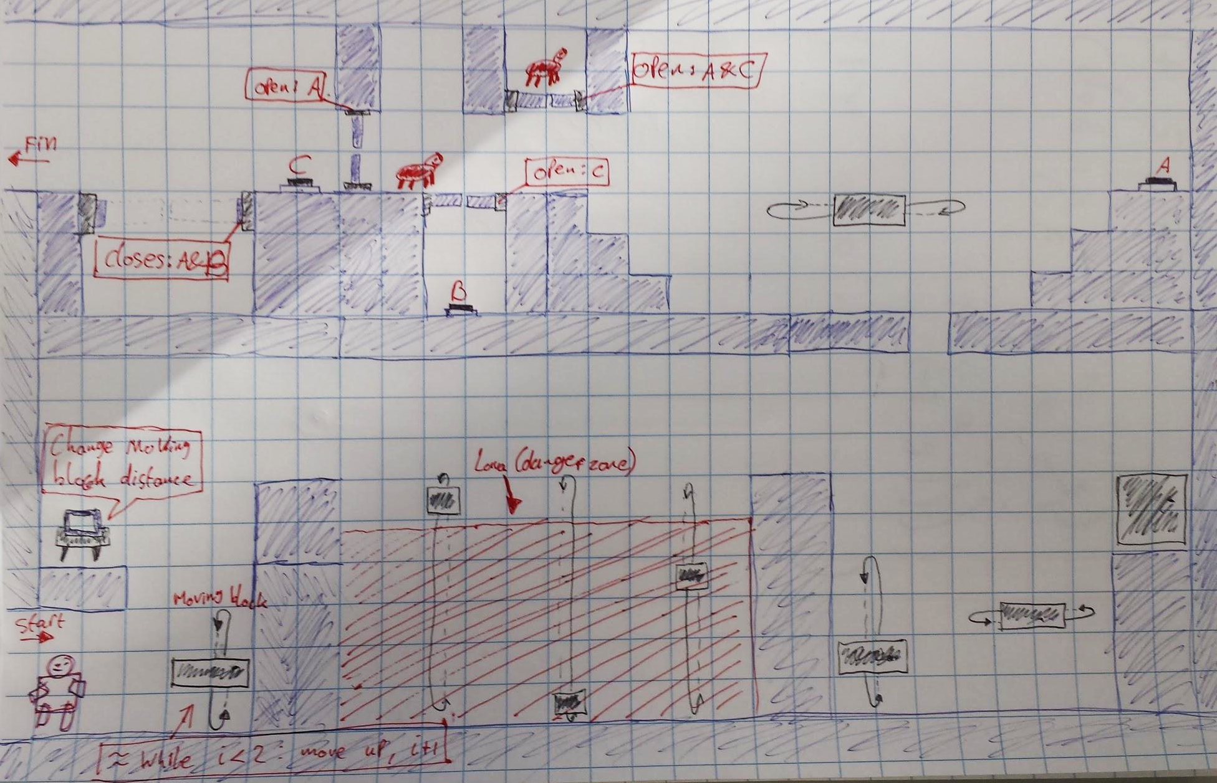
> Some concept levels
Notes:
Level design (2)
Some more complicated ideas
Moving platforms (programmable)
Resize enemies
Switches
Play with solidity of certain blocks
Some experiments with loops (still work to do here)
Functions?

Slide 10
> Tools
Phaser HTML5 game framework
Used to create the Pixel Evolution game of last year
HTML5 (Canvas/WebGL) + JavaScript
Jquery Terminal
Command line interpreter
Emulate javascript commands in the game
Inkscape
Vector graphics

Slide 11

> End
questions.forEach(function(q) {
ask(q);
})

